Slide 1







Slide 2















Slide 3













Slide 4



book
table
welcome.html
RecordServlet.java
RecordVO.java
add.jsp
RecordServlet.java
RecordBookDAO.java
list.jsp
SetData.java
RecordServlet.java
BookAddVO.java
update.jsp
RecordServlet.java
graph.jsp

Slide 5



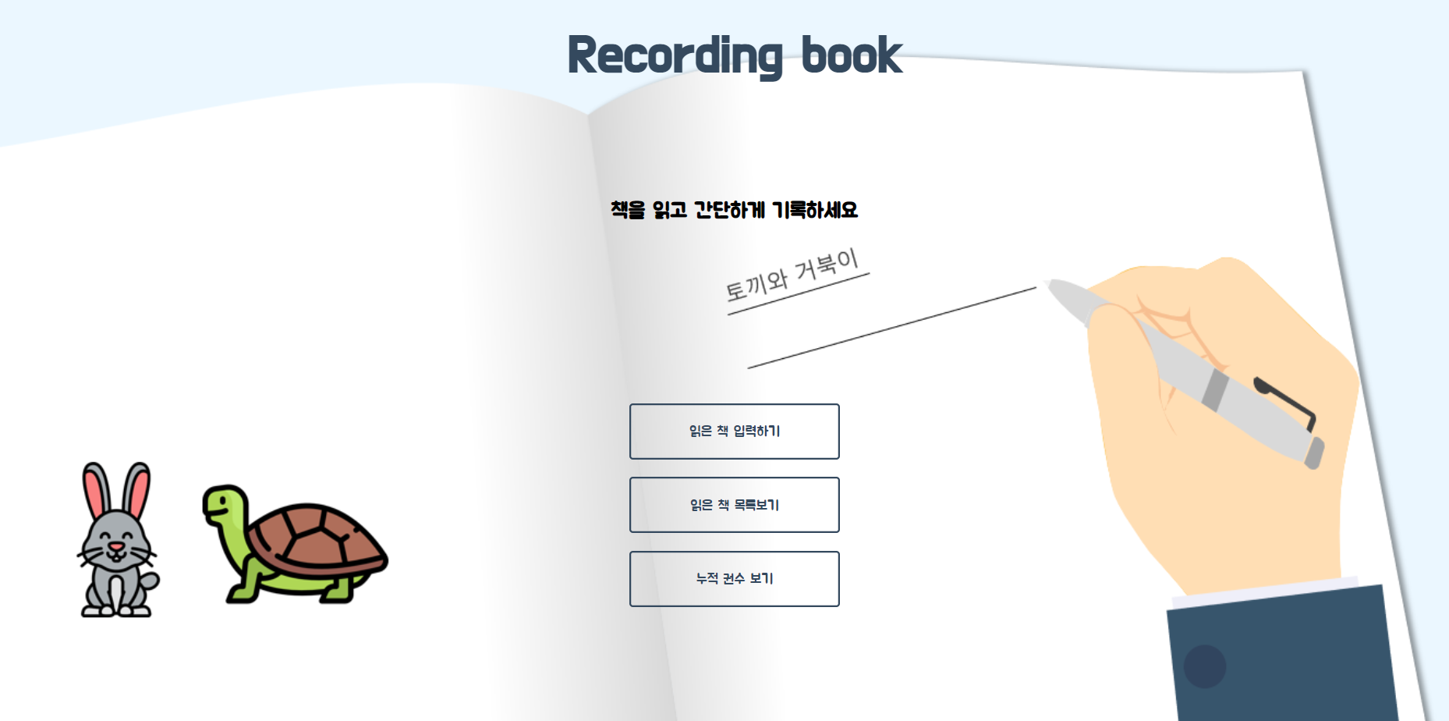




Slide 6
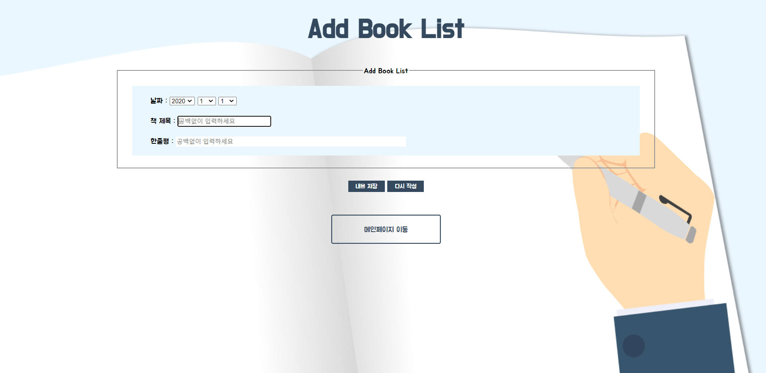
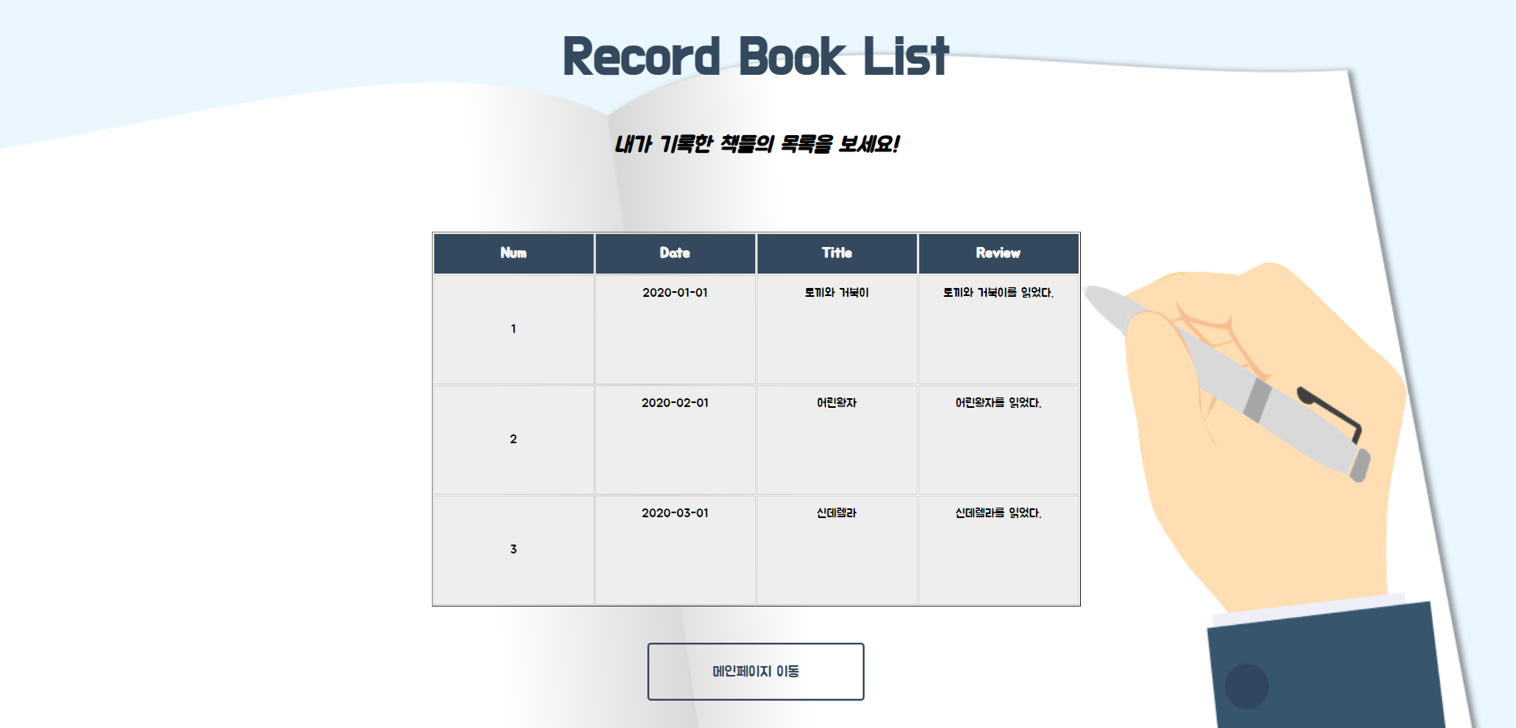



Slide 7
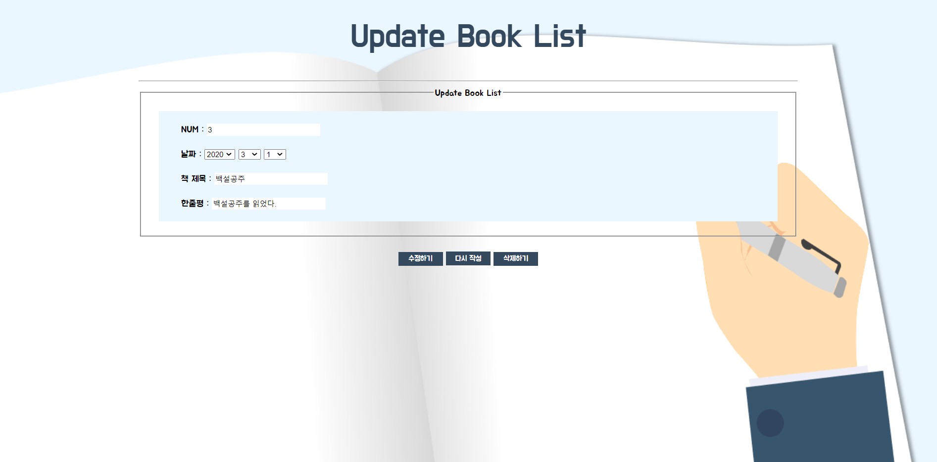
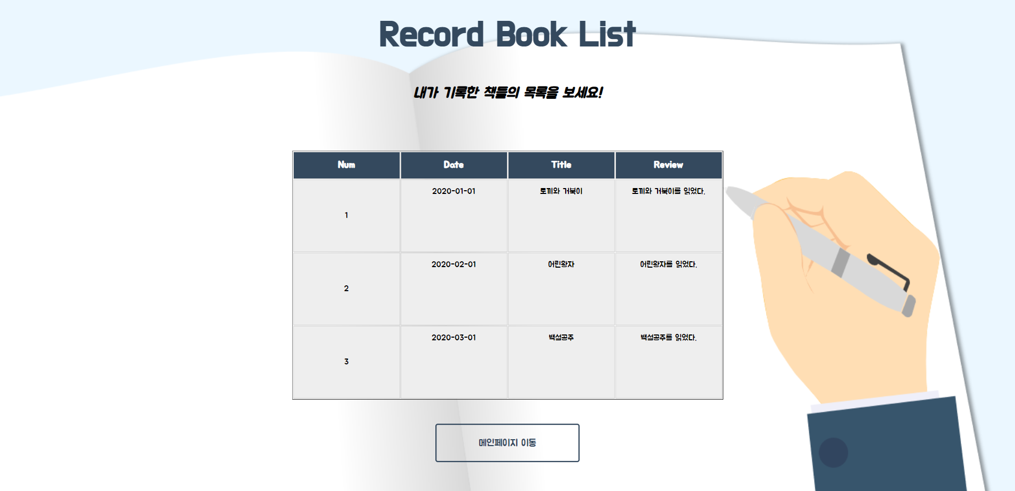
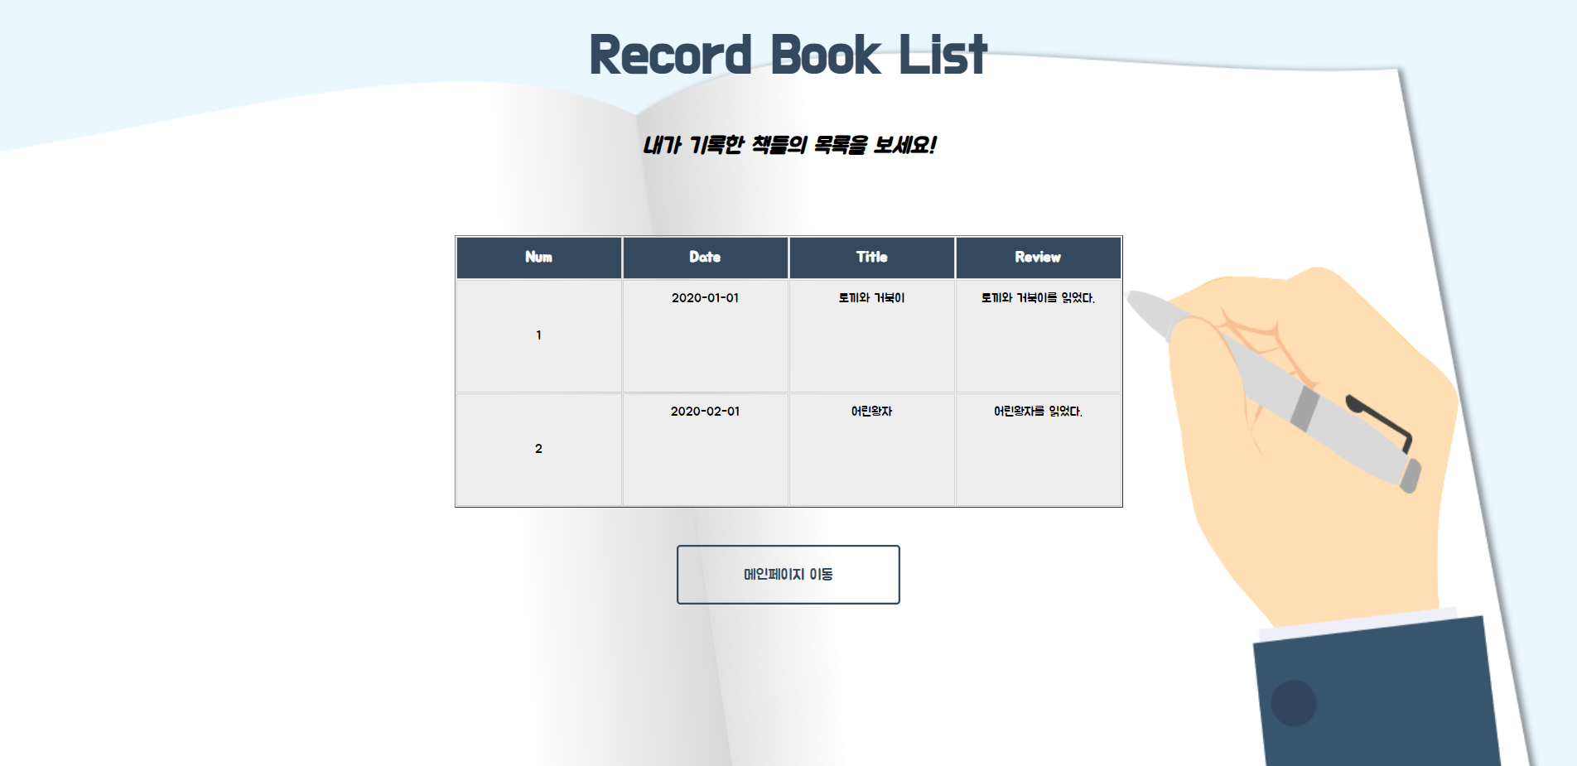


Slide 8
